Slide 1
Deepfake Detection Model
Name:
Date:

Slide 2
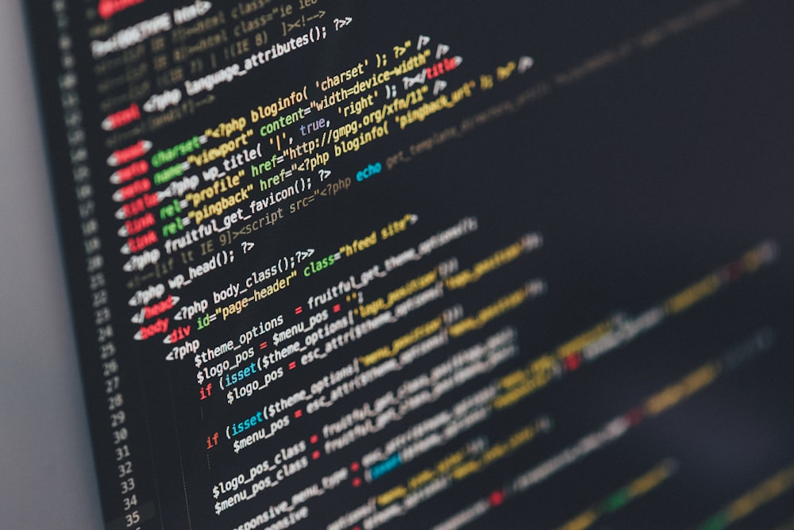
Introduction to Deepfake Detection
Objective. Develop high precision detectors using deep learning to differentiate in between real and fake images reliably.
Challenges. Deepfakes threaten identity theft, privacy violations and spread misinformation, impacting journalism, entertainment and national security.
Goal. Implement advanced AI algorithms for the detection of deepfakes with higher precision, ensuring the integrity of media.

Slide 3

Data Collection
Dataset source. Utilized Kaggle’s real vs. fake faces dataset for diverse training data.
Preprocessing steps. Images standardized to 64x64 pixels using OpenCV in order to ensure uniformity and better training.
Label Assignments. Automated sorting and labelling of images into real(0) and fake (1) in order to facilitate efficient model training and learning.

Slide 4
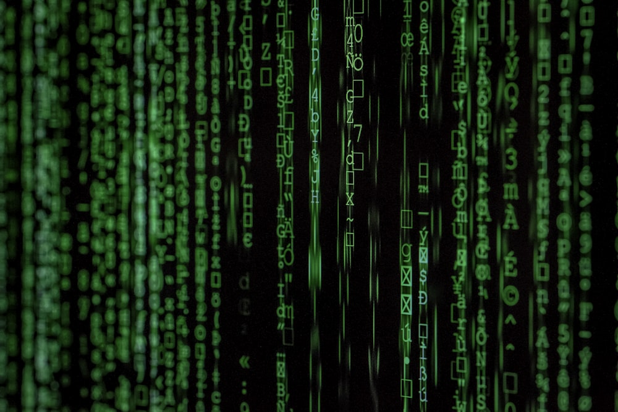
Model Architecture
Convolutional layers. Extract spatial features from images, crucial for recognizing manipulated areas.
Max-Pooling Layers. Reduce dimensionality while retaining important features, helping in computational efficiency.
Dense and Dropout layers. Classify images and manage overfitting by deactivating neurons randomly to improve generalization.

Slide 5
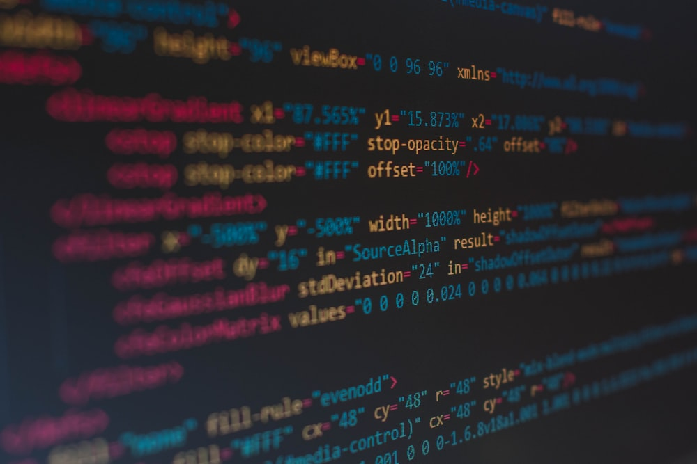
Data Splitting and Model Training
Training set. Primary dataset which is used to train the model, exposing it to diverse scenarios of real and fake images.
Validation set. Comprises 15% of the training data, used in monitoring and fine-tuning the model development.
Testing set. Critical for evaluation of the models performance on new, unseen data, ensuring its effectiveness in the real-world applications.

Slide 6
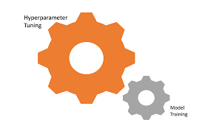
Hyperparameter Tuning
Random Search Method. A systematic approach to explore hyperparameter values in order to find the optimal settings for accuracy and generalization.
Optimization Goals. Focus on achievement of high accuracy and generalization by selecting the best hyperparameter combinations through an extensive testing.

Slide 7

Model Training and Data Augmentation.
Data Augmentation. Applies transformations like rotation, shifting and zooming to training images in order to enhance the models fault and generalization.
Batch and Epoch Training. Utilizes batch training in order to optimize learning and memory usage, with multiple epochs in order to ensure thorough learning and validation.

Slide 8

Model evaluation
Test Loss and Accuracy. Reported test loss of 0.691994 and accuracy of approximately 53%; indicating areas for improvement.
Evaluation Methods. Utilized a held-out test set in order to provide a non-biased assessment of the model’s real-world applicability and performance.

Slide 9

Performance Metrics
Validation Accuracy. Achieved up to 57% during hyperparameter tuning, indicating potential areas for enhancement.
Test Performance. Test accuracy of over 53% highlights the model’s capability to generalize from the training data to new, unseen scenarios.

Slide 10
Recommendations for Improvement
Hyperparameter Optimization. Refining convolutional and dense layer parameters to enhance model accuracy and reduce overfitting.
Adopting New Techniques. Suggests the use of ensemble learning and adversarial training to enhance robustness and defend against sophisticated attacks.

Slide 11

Convolutional Neural Network Layers
Layer Details. Conv2D layers for initial feature extraction; MaxPooling2D layers reduce spatial dimensions, preserving essential features.
Spatial Feature Recognition. These layers detect crucial visual elements like edges and textures, integral for distinguishing real from fake images.

Slide 12
Dense and Dropout Layers
Functionality. Dense layers classify images based on learned features, while dropout layers randomly deactivate the neurons in order to prevent overfitting.
Generalization. Dropout enhances the model robustness, improving the model’s ability in generalize from training data to unseen data.

Slide 13
Model Optimization Techniques
Dropout Regularization. Specific dropout rates were used to effectively minimize overfitting, enhancing the model’s ability in performing well on new, unseen data.
Hyperparameter Tuning. Utilized Keras Tuner with Random Search to systematically explore and optimize convolutional and dense layer parameters for better performance.

Slide 14
Conclusion
Key Outcomes. Developed a model with a 57% validation accuracy which is capable of differentiating real form fake images.
Recommendations for future work. Emphasize hyperparameter refinement, advanced regularization and exploration of ensemble methods in order to enhance the model’s performance.
Continued Importance. Highlighted the necessity of continuous innovations in order to counter evolving deepfake technologies and maintain media integrity.

Slide 15
References
Almars, A. M. (2021). Deepfakes detection techniques using deep learning: a survey. Journal of Computer and Communications, 9(05), 20-35.
Dolhansky, B., Bitton, J., Pflaum, B., Lu, J., Howes, R., Wang, M., & Ferrer, C. C. (2020). The deepfake detection challenge (dfdc) dataset—arXiv preprint arXiv:2006.07397.
Dong, S., Wang, J., Liang, J., Fan, H., & Ji, R. (2022, October). I am explaining deepfake detection by analyzing image matching. In European Conference on Computer Vision (pp. 18-35). Cham: Springer Nature Switzerland.
Kwon, P., You, J., Nam, G., Park, S., & Chae, G. (2021). Kodf: A large-scale Korean deepfake detection dataset. In Proceedings of the IEEE/CVF International Conference on Computer Vision (pp. 10744–10753).
Liao, L., Li, H., Shang, W., & Ma, L. (2022). An empirical study of the impact of hyperparameter tuning and model optimization on the performance properties of deep neural networks. ACM Transactions on Software Engineering and Methodology (TOSEM), 31(3), 1-40.

